Slide 1
OpenGL Texture Mapping
Matt Evett
Dept. of Computer Science
Eastern Michigan University

Slide 2
Objectives
Introduce the OpenGL texture functions and options
OpenGL Texture Mapping © Matt Evett 2004 & Addison-Wesley 2002

Slide 3
Basic Stragegy
Three steps to applying a texture
  specify the texture
    read or generate image
    assign to texture
    enable texturing
  assign texture coordinates to vertices
    Proper mapping function is left to application
  specify texture parameters
    wrapping, filtering
OpenGL Texture Mapping © Matt Evett 2004 & Addison-Wesley 2002

Slide 4
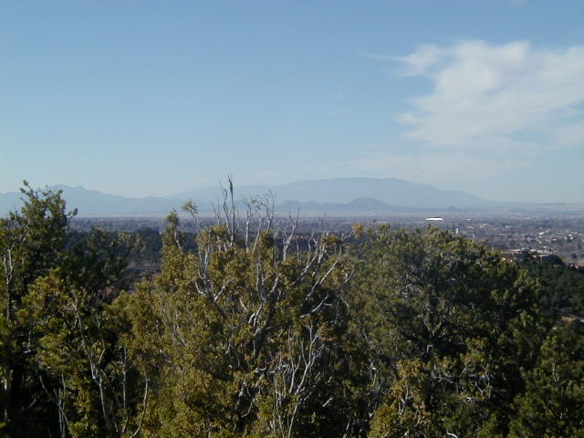
Texture Mapping
y
z
x
geometry
screen
t
image
s
OpenGL Texture Mapping © Matt Evett 2004 & Addison-Wesley 2002

Slide 5
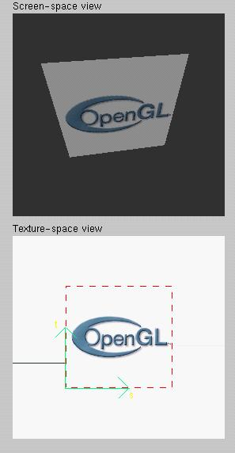
Texture Example
The texture (below) is a 256 x 256 image that has been mapped to a rectangular polygon which is viewed in perspective
OpenGL Texture Mapping © Matt Evett 2004 & Addison-Wesley 2002

Slide 6
Texture Mapping and the OpenGL Pipeline
Images and geometry flow through separate pipelines that join at the rasterizer
  “complex” textures do not affect geometric complexity
vertices
geometry pipeline
rasterizer
image
pixel pipeline
OpenGL Texture Mapping © Matt Evett 2004 & Addison-Wesley 2002

Slide 7
Specify Texture Image
Define a texture image from an array of
texels (texture elements) in CPU memory
  Glubyte my_texels[512][512];
Define as any other pixel map
  Convert jpeg, etc
  Scan
  Via application code
Enable texture mapping
  glEnable(GL_TEXTURE_2D)
  OpenGL supports 1-4 dimensional texture maps
OpenGL Texture Mapping © Matt Evett 2004 & Addison-Wesley 2002

Slide 8
Define Image as a Texture
glTexImage2D( target, level, components,
w, h, border, format, type, texels );
target: type of texture, e.g. GL_TEXTURE_2D
level: used for mipmapping (discussed later)
components: color elements per texel
w, h: width and height of texels in pixels
border: used for smoothing (discussed later)
format and type: describe texels
texels: pointer to texel array
glTexImage2D(GL_TEXTURE_2D, 0, 3, 512, 512, 0, GL_RGB, GL_UNSIGNED_BYTE, my_texels);
OpenGL Texture Mapping © Matt Evett 2004 & Addison-Wesley 2002
Notes:
Textures are usually stored in the graphics card’s memory

Slide 9
Converting A Texture Image
OpenGL requires texture dimensions to be powers of 2
If dimensions of image are not powers of 2
gluScaleImage( format, w_in, h_in,
type_in, *data_in, w_out, h_out,
type_out, *data_out );
  data_in is source image
  data_out is for destination image
Image interpolated and filtered during scaling
OpenGL Texture Mapping © Matt Evett 2004 & Addison-Wesley 2002
Notes:
If

Slide 10
Mapping a Texture
Based on parametric texture coordinates
glTexCoord*() specified at each vertex
Texture Space
Object Space
t
1, 1
(s, t) = (0.2, 0.8)
0, 1
A
a
c
(0.4, 0.2)
b
B
C
0, 0
1, 0
s
(0.8, 0.4)
OpenGL Texture Mapping © Matt Evett 2004 & Addison-Wesley 2002
Notes:
Note orientation of the silhouetted triangle in the left image and resulting triangle in right image

Slide 11
Typical Code
glBegin(GL_POLYGON);
glColor3f(r0, g0, b0);
glNormal3f(u0, v0, w0);
glTexCoord2f(s0, t0);
glVertex3f(x0, y0, z0);
glColor3f(r1, g1, b1);
glNormal3f(u1, v1, w1);
glTexCoord2f(s1, t1);
glVertex3f(x1, y1, z1);
.
.
glEnd();
Note that we can use vertex arrays to increase efficiency
OpenGL Texture Mapping © Matt Evett 2004 & Addison-Wesley 2002

Slide 12
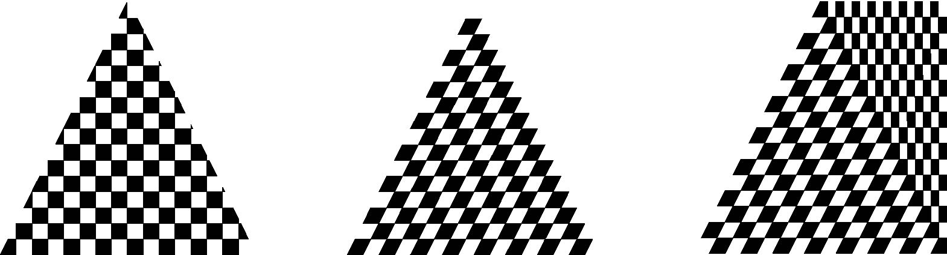
Interpolation
OpenGL uses bilinear interpolation to find proper texels from specified texture coordinates
Can be distortions
texture stretched
over trapezoid
showing effects of
bilinear interpolation
good selection
of tex coordinates
poor selection
of tex coordinates
OpenGL Texture Mapping © Matt Evett 2004 & Addison-Wesley 2002

Slide 13
Texture Parameters
OpenGL has a variety of parameters that determine how texture is applied
  Wrapping parameters determine what happens of s and t are outside the (0,1) range
  Filter modes allow us to use area averaging instead of point samples
  Mipmapping allows us to use textures at multiple resolutions
  Environment parameters determine how texture mapping interacts with shading
OpenGL Texture Mapping © Matt Evett 2004 & Addison-Wesley 2002

Slide 14
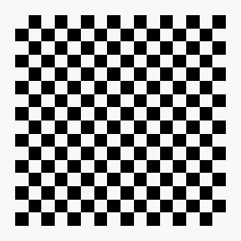
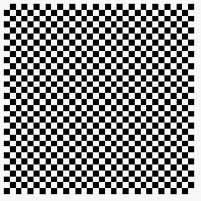

Wrapping Mode
Clamping: if s,t > 1 use 1, if s,t <0 use 0
  glTexParameteri( GL_TEXTURE_2D,
  GL_TEXTURE_WRAP_S, GL_CLAMP )
Wrapping: use s,t modulo 1
  glTexParameteri( GL_TEXTURE_2D,
  GL_TEXTURE_WRAP_T, GL_REPEAT )
t
s
GL_REPEAT
wrapping
GL_CLAMP
texture
OpenGL Texture Mapping © Matt Evett 2004 & Addison-Wesley 2002

Slide 15
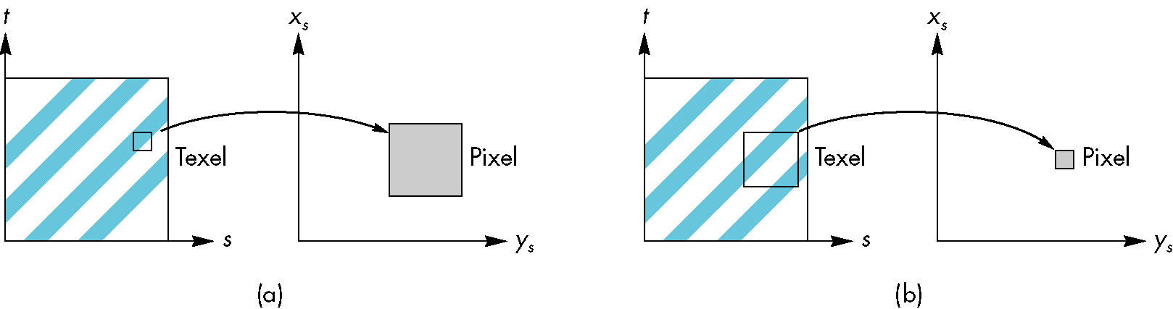
Mag/Min-ification
OpenGL Texture Mapping © Matt Evett 2004 & Addison-Wesley 2002

Slide 16
Magnification and Minification
More than one texel can cover a pixel (minification) or
more than one pixel can cover a texel (magnification)
Can use point sampling (nearest texel) (may yield aliasing)
or linear filtering (2 x 2 texel avg.) to obtain texture values
Texture
Polygon
Texture
Polygon
Magnification
Minification
OpenGL Texture Mapping © Matt Evett 2004 & Addison-Wesley 2002
Notes:
Minification can be particularly problematic because of aliasing

Slide 17
Filter Modes
Modes determined by
  glTexParameteri( target, type, mode )
glTexParameteri(GL_TEXTURE_2D, GL_TEXURE_MAG_FILTER,
GL_NEAREST);
glTexParameteri(GL_TEXTURE_2D, GL_TEXURE_MIN_FILTER,
GL_LINEAR);
Note that linear filtering requires a border of an
extra texel for filtering at edges (border = 1, in call to
glTexImage2d)
OpenGL Texture Mapping © Matt Evett 2004 & Addison-Wesley 2002
Notes:
Extra border is needed at edges, because the selected texel area may exceed the size of the texture map.

Slide 18
Mipmapped Textures
Mipmapping allows for prefiltered texture maps of decreasing resolutions
Lessens interpolation errors for smaller textured objects
Declare mipmap level (0 = orig. image, 1 = image at half resolution) during texture definition
  glTexImage2D( GL_TEXTURE_*D, level, … )
GLU mipmap builder routines will build all the textures from a given image
  gluBuild*DMipmaps( … )
OpenGL Texture Mapping © Matt Evett 2004 & Addison-Wesley 2002

Slide 19
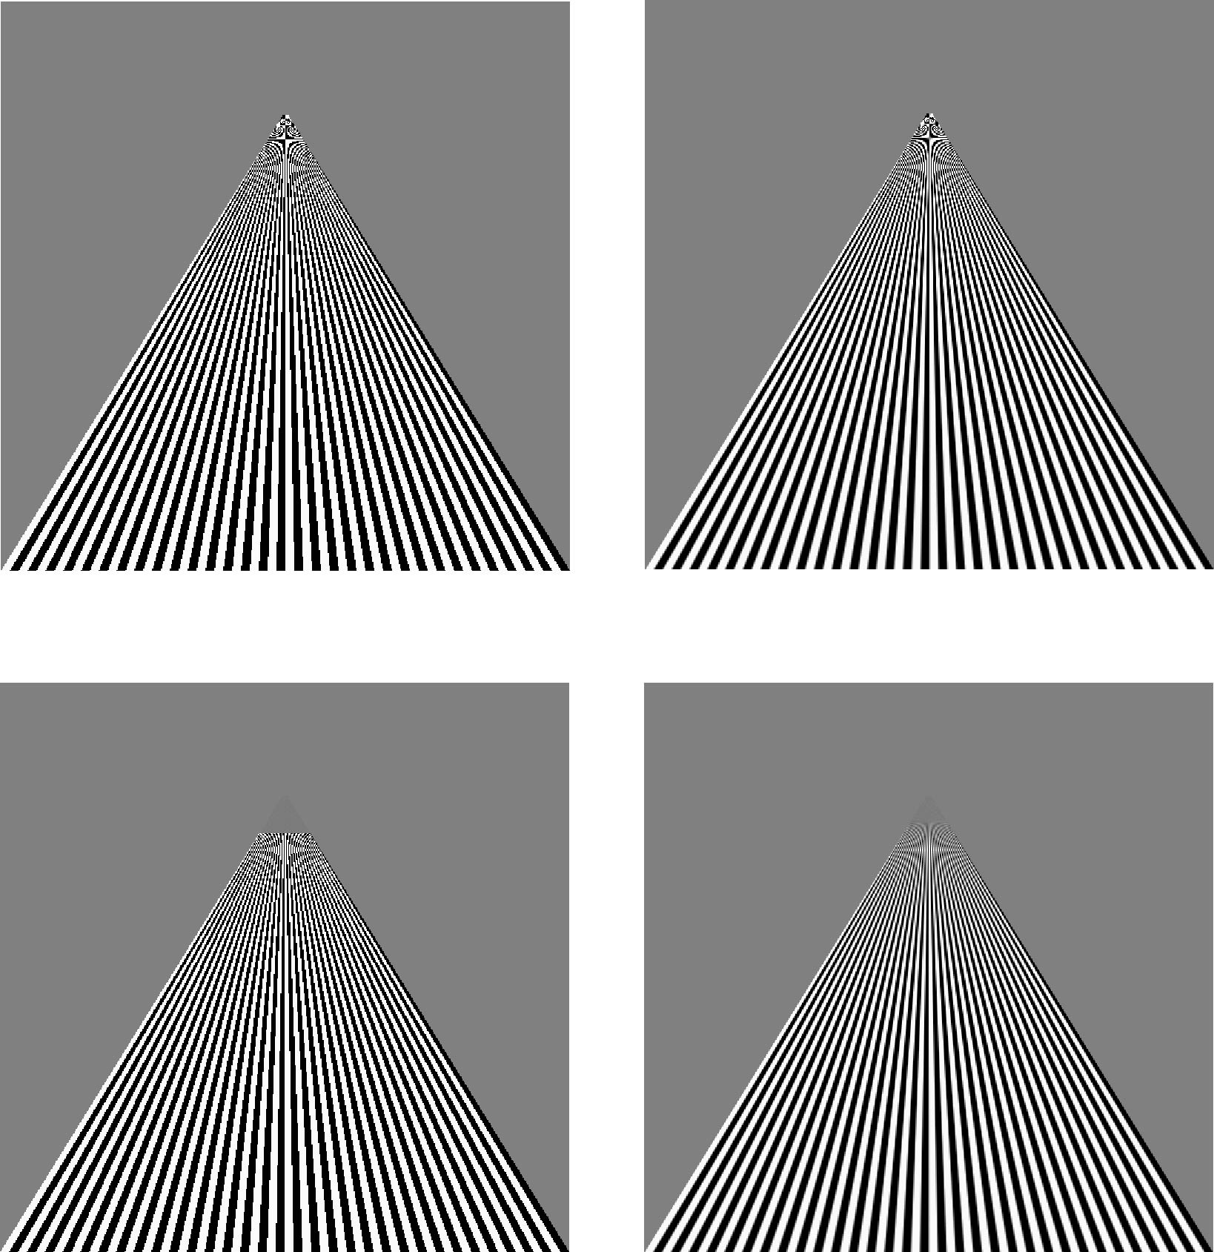
Example
point
sampling
linear
filtering
mipmapped
point
sampling
mipmapped
linear
filtering
OpenGL Texture Mapping © Matt Evett 2004 & Addison-Wesley 2002
Notes:
Farthest mapmaped pixels are grey and so blend with background
Linear filtering does similarly with areas between stripes grey, rather than black/white.

Slide 20
Texture Functions
Controls how texture is applied—interaction with shading
glTexEnv{fi}[v]( GL_TEXTURE_ENV, prop, param )
GL_TEXTURE_ENV_MODE modes
  GL_MODULATE: modulates with computed shade
  GL_BLEND: blends with an environmental color
  GL_DECAL: use only texture color
  GL(GL_TEXTURE_ENV, GL_TEXTURE_ENV_MODE, GL_MODULATE);
Set blend color with GL_TEXTURE_ENV_COLOR
OpenGL Texture Mapping © Matt Evett 2004 & Addison-Wesley 2002
Notes:
Modulate = multiply color components fromshading with those of texture

Slide 21
Perspective Correction Hint
Texture’s bilinear interpolation does not integrate well with perspective (it is nonlinear).
Texture coordinate and color interpolation
  either linearly in screen space
  or using depth/perspective values (slower, but most GPUs now support this)
Noticeable for polygons “on edge”
glHint( GL_PERSPECTIVE_CORRECTION_HINT, hint )
  where hint is one of
    GL_DONT_CARE
    GL_NICEST
    GL_FASTEST
OpenGL Texture Mapping © Matt Evett 2004 & Addison-Wesley 2002

Slide 22
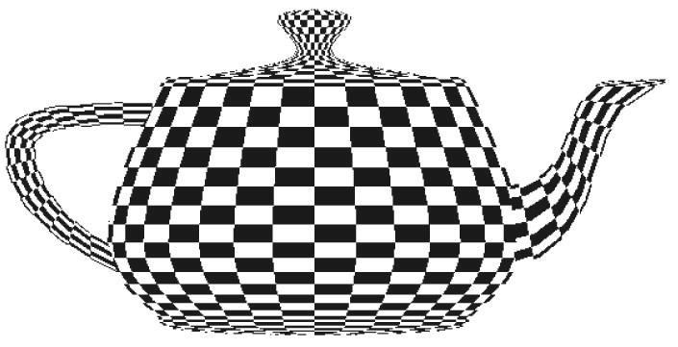
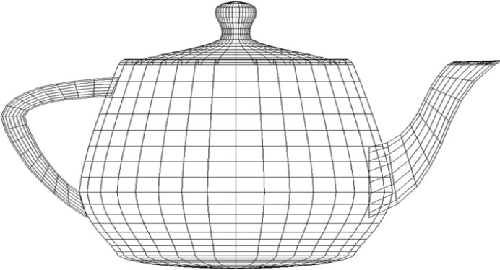
Mapping to Complex Surface
Utah Teapot
  Though comprised of only quadrilaterals, they are of very different sizes, so selection of texel coords per object vertex is difficult
OpenGL Texture Mapping © Matt Evett 2004 & Addison-Wesley 2002

Slide 23
Generating Texture Coordinates
OpenGL can generate texture coordinates automatically
  glTexGen{ifd}[v]()
specify a plane
  generate texture coordinates based upon distance of vertex from a plane, yielding a linear combination
  s=ax +by +cz+dw; t=ex+fy+gz+hw
generation modes
  GL_OBJECT_LINEAR (see Fig 8.35)
  GL_EYE_LINEAR (gives illusion of object passing through a fixed field)
  GL_SPHERE_MAP (used for environmental maps)
OpenGL Texture Mapping © Matt Evett 2004 & Addison-Wesley 2002

Slide 24
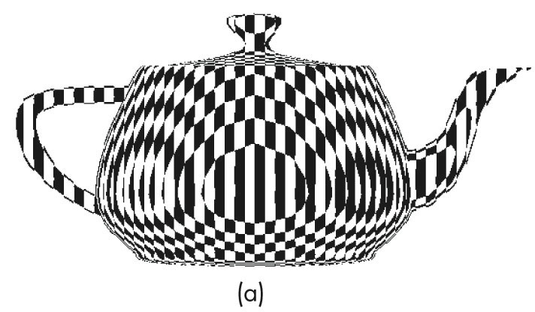
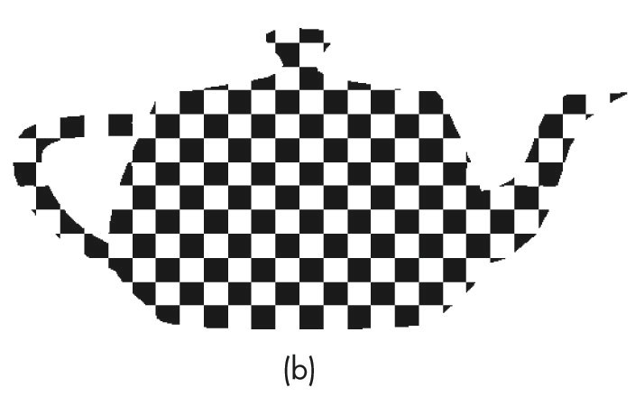
Generated Texture Coords
OpenGL generated textures using a)object coords, b) eye coords
OpenGL Texture Mapping © Matt Evett 2004 & Addison-Wesley 2002

Slide 25
Texture Matrix
Texture coords are stored as 4-element matrices (a vector).
Can be manipulated by the texture matrix, just as other transformation matrices manipulate vertices.
Can be used to scale and orient textures to create effects.
glMatrixMode(GL_TEXTURE)
OpenGL Texture Mapping © Matt Evett 2004 & Addison-Wesley 2002

Slide 26
Texture Objects
Texture is part of the OpenGL state
  If we have different textures for different objects, OpenGL will be moving large amounts data from processor memory to texture memory
Recent versions of OpenGL have texture objects
  one image per texture object
  Texture memory can hold multiple texture obejcts
OpenGL Texture Mapping © Matt Evett 2004 & Addison-Wesley 2002

Slide 27
Applying Textures II
specify textures in texture objects
set texture filter
set texture function
set texture wrap mode
set optional perspective correction hint
bind texture object
enable texturing
supply texture coordinates for vertex
  coordinates can also be auto-generated
OpenGL Texture Mapping © Matt Evett 2004 & Addison-Wesley 2002

Slide 28
Multitexturing
Apply a sequence of textures through cascaded texture units
Example: a shadow texture applied to an already textured surface.
OpenGL Texture Mapping © Matt Evett 2004 & Addison-Wesley 2002

Slide 29
Environmental Maps
Start with image of environment through a wide angle lens
  Can be either a real scanned image or an image created in OpenGL
Use this texture to generate a spherical map
Use automatic texture coordinate generation
OpenGL Texture Mapping © Matt Evett 2004 & Addison-Wesley 2002

Slide 30
Bump Maps
Moving a texture-mapped orange will not appear realistic because the colors won’t change.
Real orange’s surface is covered with many small perturbations.
Bump mapping alters the surface normals to mimic the perturbations.
Not directly supported by OpenGL
OpenGL Texture Mapping © Matt Evett 2004 & Addison-Wesley 2002

